Slide 1

SMASH: Co-designing Software Compression and Hardware-Accelerated Indexing for Efficient Sparse Matrix Operations
MICRO2019
孙澄宇

Slide 2
1 INTRODUCTION
Sparse linear algebra operations are widely used in modern applications like recommender systems ,neural networks , graph analytics , and high-performance computing .
The matrices involved in these operations are very large in size and highly sparse, i.e., the vast majority of the elements are zeros.
For example, the matrices that represent Facebook’s and YouTube’s social network connectivity contain 0.0003% and 2.31% non-zero elements, respectively.
These highly sparse matrices lead to significant inefficiencies in both storage and computation.

Slide 3
1 INTRODUCTION
Prior works take two major approaches to designing such compression schemes.
The first approach is to devise general compression formats or encodings:
store the non-zero elements and their positions using additional data structures and different encodings.
The second approach is to leverage a certain known structure in a given type of sparse matrix.

Slide 4
1 INTRODUCTION
GOAL:
three major requirements:
high computation and storage efficiency
minimal overheads from the compression scheme (e.g., efficient discovery of non-zero elements)
generality and applicability to any sparse matrix, regardless of its structure or the extent of its sparsity.

Slide 5
1 INTRODUCTION
We propose SMASH (Sparse MAtrix Software/Hardware), a general hardware-software cooperative mechanism that efficiently compresses and operates on sparse matrices. The key construct behind SMASH is the use of efficiently encoded hierarchical bitmaps to express sparsity, where each bit represents a region of non-zero values.
On the hardware side, the bitmap representation allows us to use a lightweight hardware unit, the Bitmap Management Unit (BMU), to perform highly-efficient scans of the bitmap hierarchy.

Slide 6
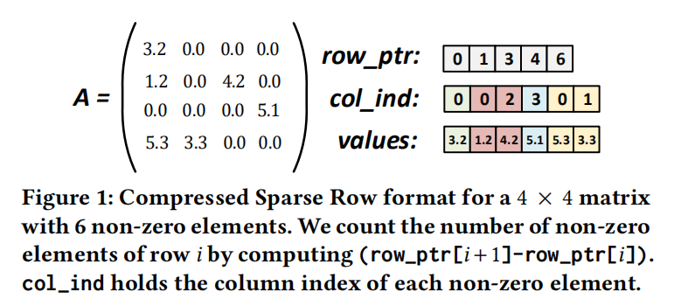
2 MOTIVATION——2.1 Compressed Storage Formats
The Compressed Sparse Row (CSR) format is widely used in many libraries that involve sparse matrix.
It consists of three one-dimensional arrays: row_ptr, col_ind, and values.

Slide 7
2 MOTIVATION——2.1 Compressed Storage Formats
However, CSR and schemes with CSR-like structures have one major requirement: in order to determine where the non-zero elements are located in the original matrix,the corresponding indices need to be retrieved from the row_ptr and col_ind data structures. Accessing these data structures adds many additional instructions overheads.

Slide 8
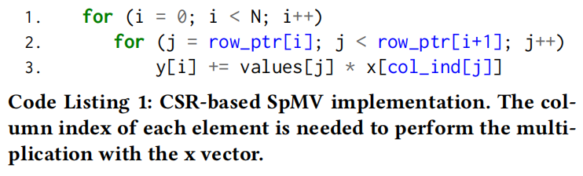
2.1.1 Sparse Matrix Vector Multiplication (SpMV).

Slide 9
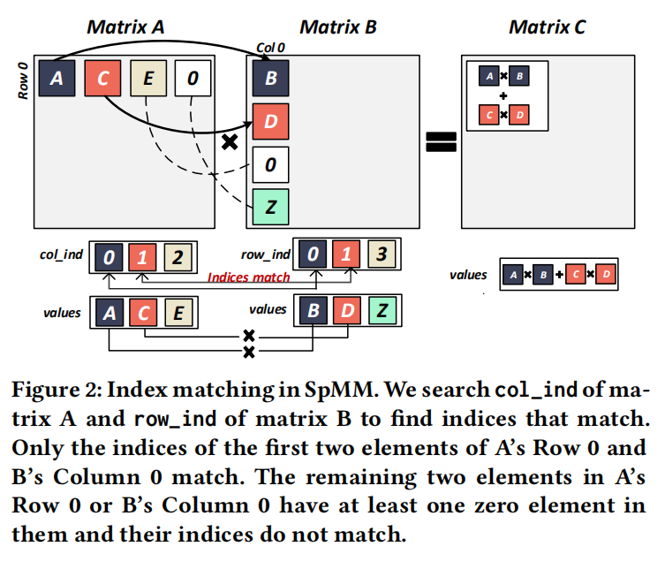
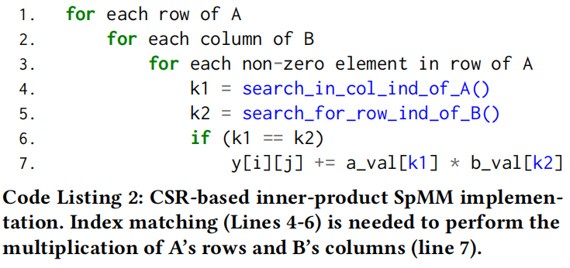
2.1.2 Sparse Matrix Matrix Multiplication (SpMM).
indexing mechanism plays a critical role in performance and efficiency.

Slide 10
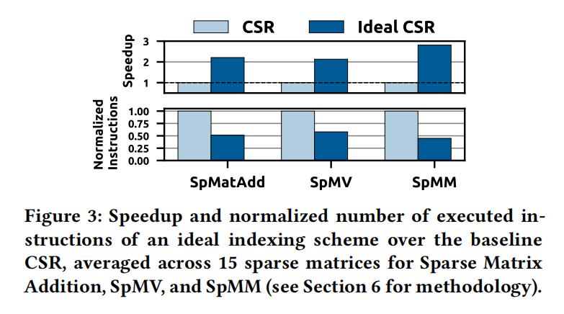
2.2 Limitations of Existing Compressed Storage Formats
they require additional computation and indirect memory accesses to find the indices, i.e., the row and column positions, of non-zero elements.

Slide 11
3 SMASH : DESIGN OVERVIEW
The key idea of SMASH is to enable the hardware to recognize
and exploit the compression encoding used in software.
We devise a new construct, recognized by both the hardware and software, to compress sparse matrices efficiently: a hierarchy of bitmaps. Each bitmap in the hierarchy efficiently encodes sparsity by denoting
the presence/absence of non-zero values in a matrix region using
a single bit.
The size of the region varies with the level of the bitmap in the hierarchy and can be adjusted by software.

Slide 12
3.1 Design Challenges
Challenge 1: Efficiently Encoding Bitmaps. We need a more efficient bitmap representation that is effective regardless of the matrix sparsity and the location/distribution of the non-zero values. At the same time, hardware should be able to flexibly interpret and leverage this bitmap encoding.
Challenge 2: Flexibility and Expressiveness. To express a diverse set of sparse matrix operations in any application, we need a rich cross-layer interface between the application and the underlying hardware.

Slide 13
3.2 SMASH: Key Components
Hierarchy of Bitmaps.
Each level of the hierarchy encodes the presence of non-zero values with a configurable compression ratio. This compression ratio is determined by the software based on the sparsity and distribution of non-zero values
in a given matrix.

Slide 14
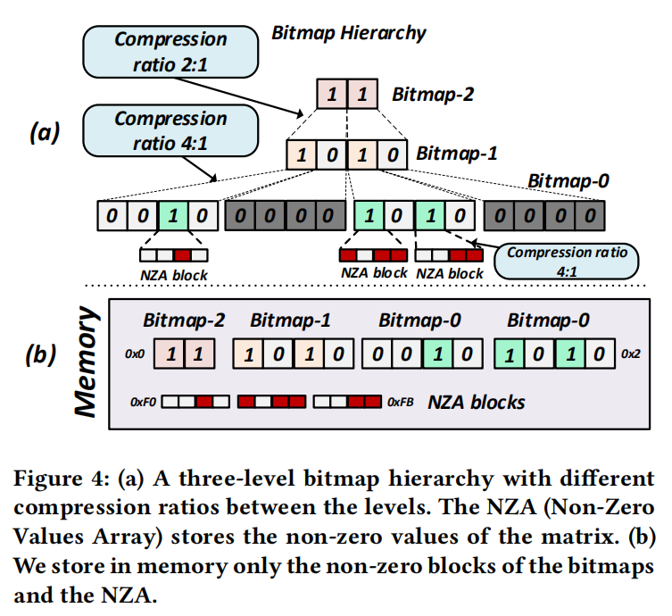
3.2 SMASH: Key Components
3-level bitmap hierarchy
tradeoff between computation efficiency and storage efficiency
The non-zero elements of the matrix are kept in a data structure called the Non-Zero Values Array (NZA).

Slide 15
4 SMASH: DETAILED DESIGN——4.1 Software Compression (Hierarchical Bitmap Compression)
The Non-Zero Values Array (NZA) holds the actual values of the sparse matrix.Every set bit of the last-level Bitmap-0 corresponds to one non zero block in the NZA.
The size of each non-zero block in the NZA(that is encoded by a single set bit in Bitmap-0) depends on the compression ratio used for Bitmap-0.
There are two major factors that impact the effectiveness of our
hierarchical bitmap compression scheme

Slide 16
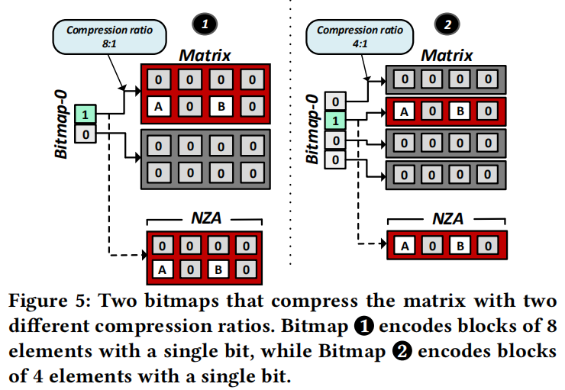
4.1.1 Impact of compression ratio.

Slide 17
4.1.2 Impact of distribution of non-zero elements in the sparse matrix.
The distribution of non-zero elements across the matrix also
affects the size of the NZA.
On the one hand, if the non-zero elements of the matrix are closely clustered, the number of non-zero blocks of the matrix decreases and the NZA stores fewer blocks.
On the other hand, if the non-zero elements of the matrix are distributed more uniformly across the matrix, the number of non-zero blocks of the matrix increases and the NZA may need to hold more non-zero blocks (that also contain more zeros).

Slide 18
4.1.3 Conversion to the hierarchical bitmap format.
Conversion to the hierarchical bitmap format. If the input data to any user application is already stored using another compression format (such as CSR), the application needs to convert the sparse matrices to the hierarchical bitmap encoding and the NZA used in SMASH.

Slide 19
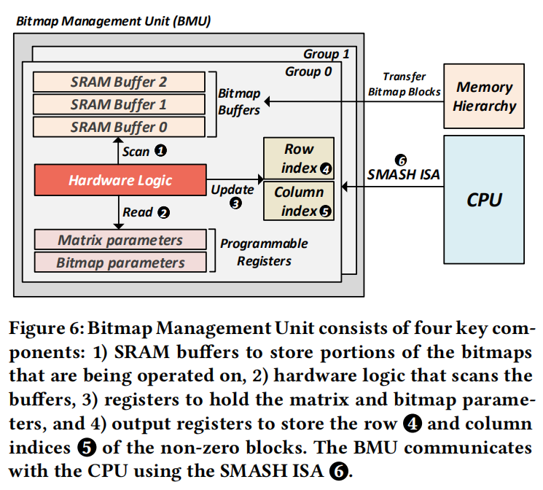
4.2 Hardware Indexing (Bitmap Management Unit)——4.2.1 BMU components.

Slide 20
4.2.3 Efficient indexing with the BMU.
The BMU iteratively communicates to the CPU the row and column indices of the non-zero elements in the sparse matrix.
The BMU traverses the hierarchy until it reaches Bitmap-0.
Any set bit in Bitmap-0 directly maps to a block of elements in the sparse matrix that has at least one non-zero element.
Using the saved indices of the set bits at each level of the hierarchy, as well as the corresponding compression ratios, the BMU calculates the index of the non-zero block in the original sparse matrix.

Slide 21
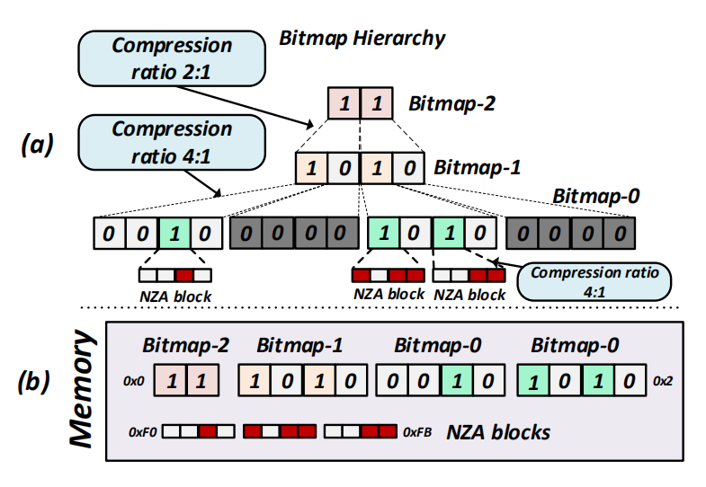
4.2.3 Efficient indexing with the BMU.
row_index = Index/matrix_columns and column_index =Index%matrix_columns.

Slide 22
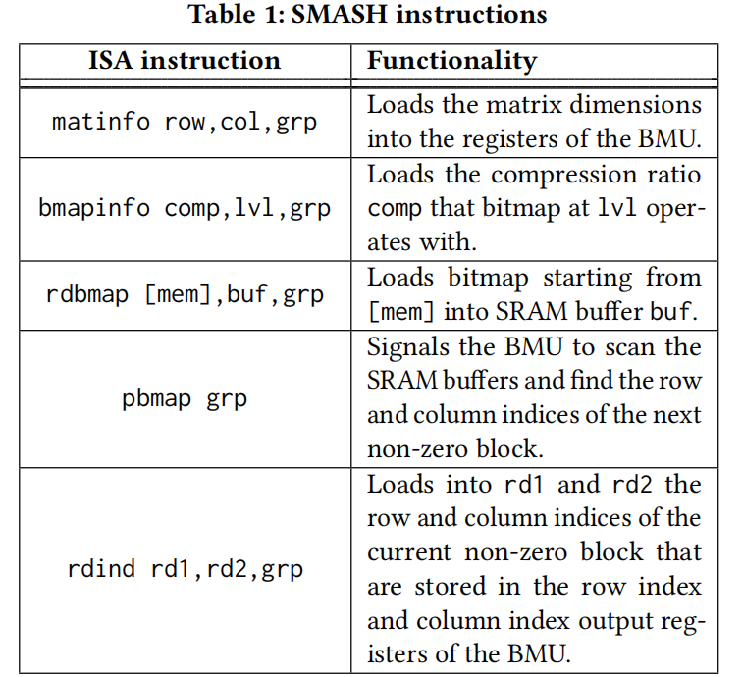
4.3 SMASH ISA: Software/Hardware Interface

Slide 23
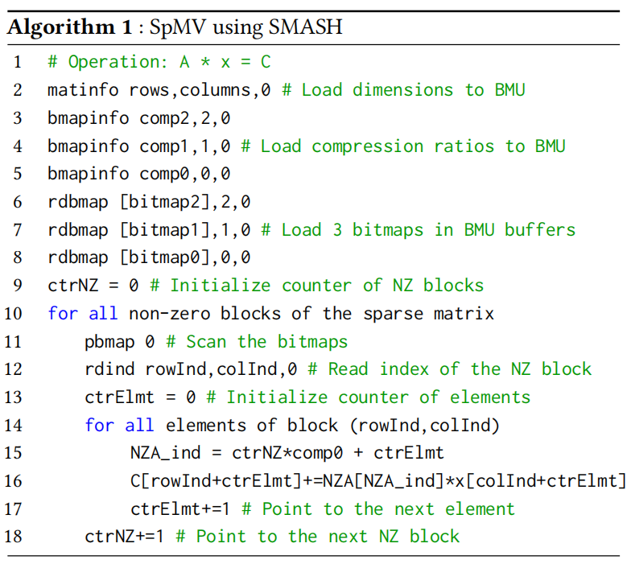
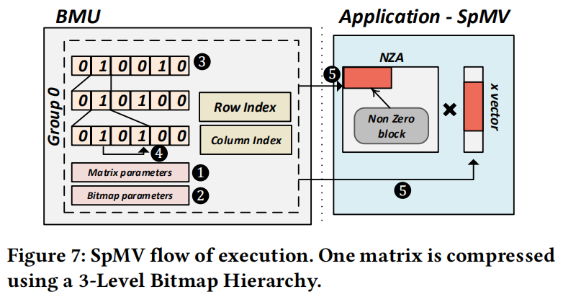
5 SMASH EXAMPLE USE CASES——5.1 Example Use Case 1: SpMV

Slide 24
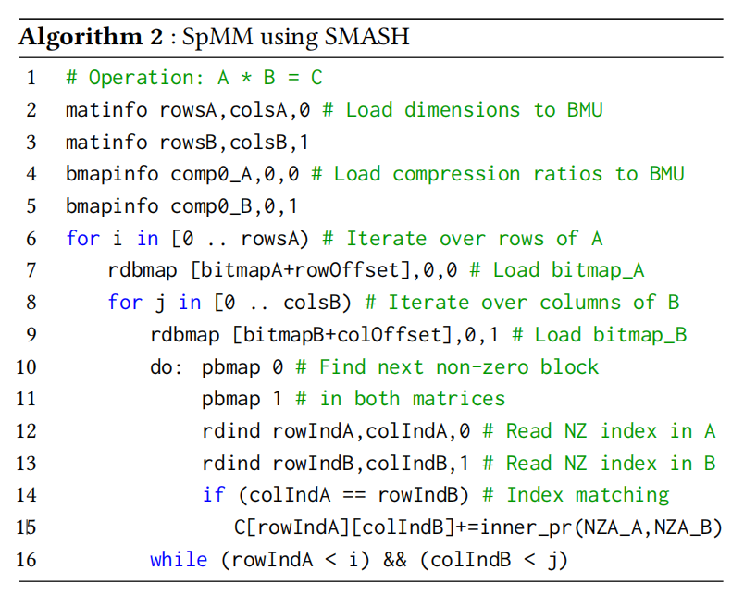
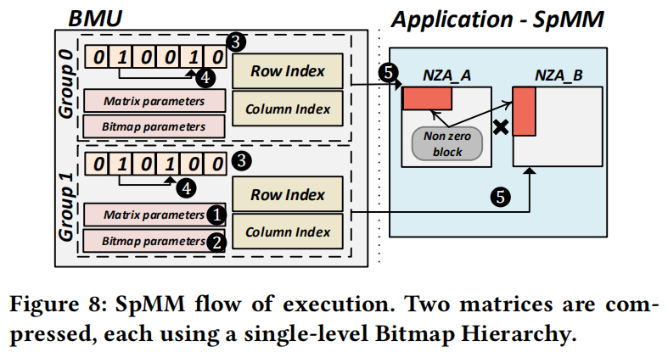
5.2 Example Use Case 2: SpMM

Slide 25
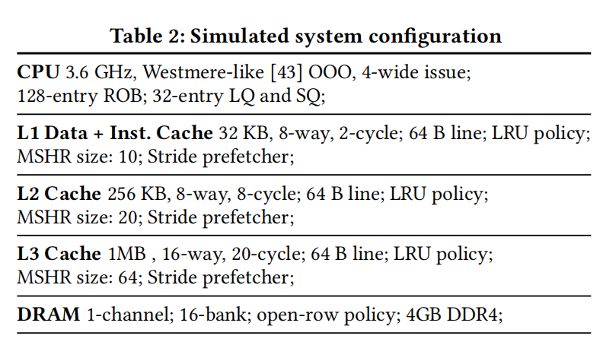
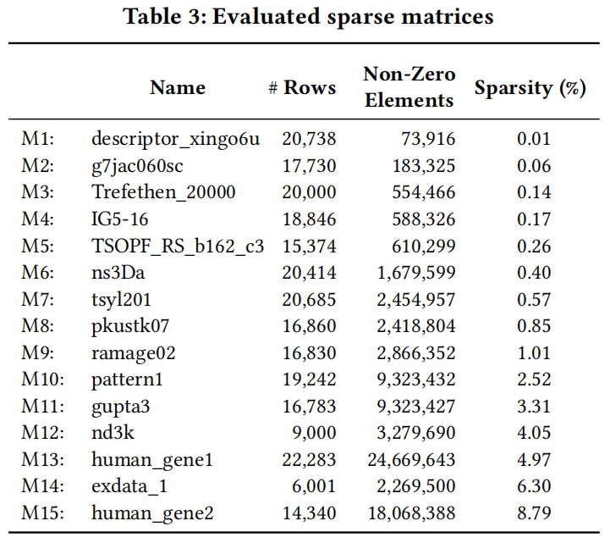
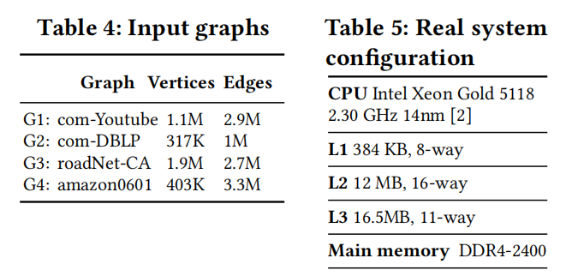
6 EXPERIMENTAL SETUP
Workloads: Sparse Matrix Kernels. Graph Processing.

Slide 26
7 EVALUATION RESULTS
We evaluate five different mechanisms: (i) TACO-CSR: The CSR-based implementation from the TACO library; (ii) TACO-BCSR: The BCSR-based implementation from the TACO library; (iii) MKL-CSR: CSR-based SpMV and SpMM implementations from Intel MKL ; (iv) Software-only SMASH: SMASH’s hierarchical bitmap encoding implemented purely in software without the BMU; and (iv) SMASH: our complete proposed scheme,with the hierarchical bitmap encoding and the BMU.

Slide 27
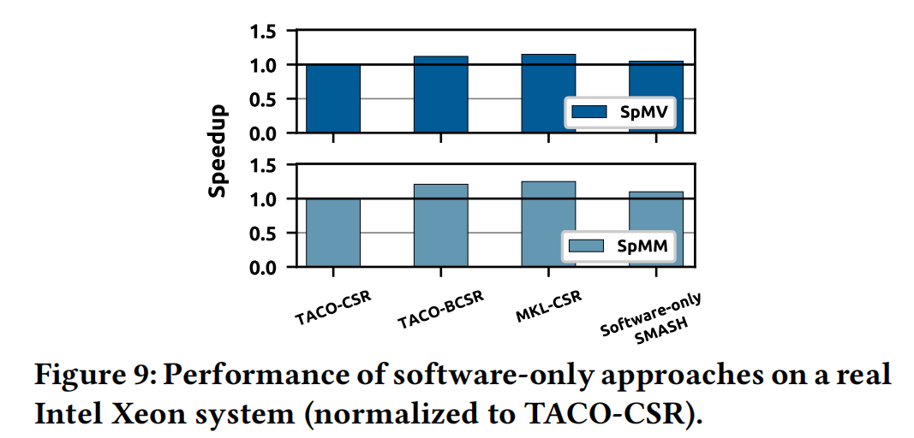
7.1 Software-only Approaches

Slide 28
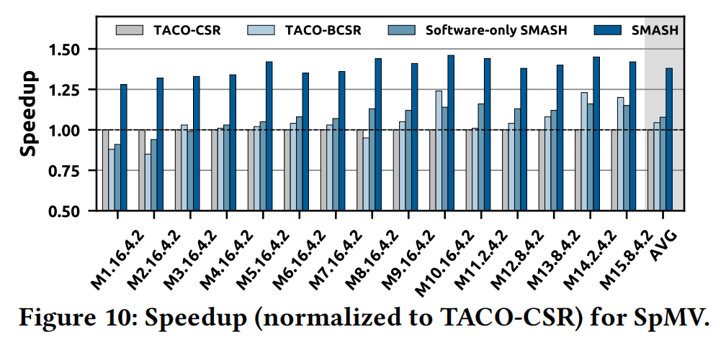
7.2 Sparse Matrix Kernels

Slide 29
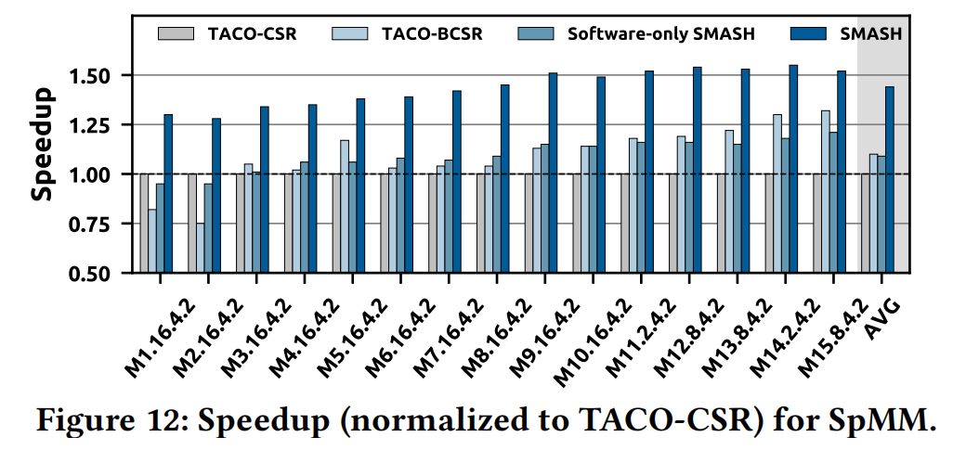
7.2 Sparse Matrix Kernels

Slide 30
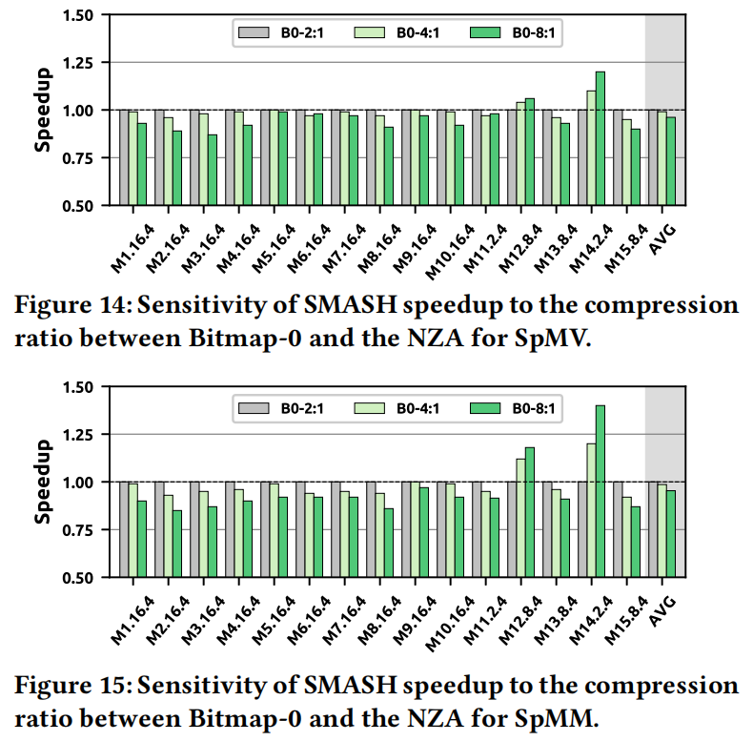
7.2 Sparse Matrix Kernels

Slide 31
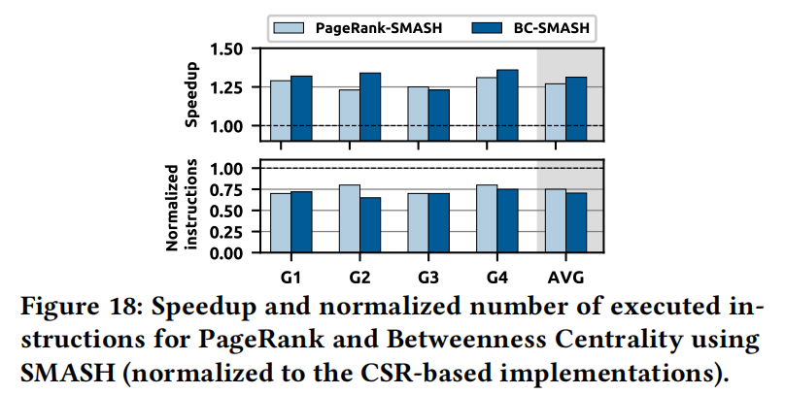
7.3 Graph Applications

Slide 32
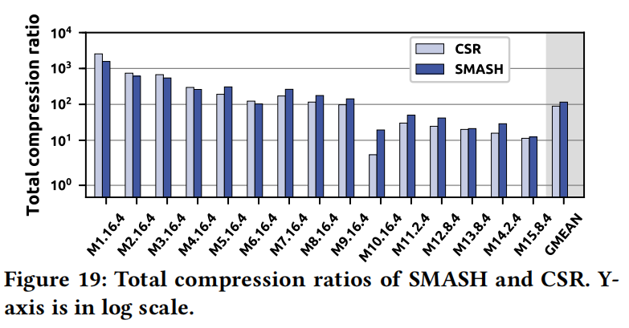
7.4 Storage Efficiency

